Slide 1
Regression Analysis
Multiple Linear Regression
Nicoleta Serban, Ph.D.
Professor
School of Industrial and Systems Engineering
Ranking States by SAT Performance: Model Fit

Slide 2

About This Lesson

Slide 3
Residual Analysis
To evaluate assumptions:
Constant variance & uncorrelated errors
  Response variable or fitted values vs residuals
Linearity
  Predicting variables vs residuals
Normality
  Histogram and QQ normal plot
To evaluate outliers:
  Cook’s distance plots

Slide 4
Residual Analysis
## Residual analysis for the reduced model
res = stdres(reduced.line)
cook = cooks.distance(reduced.line)
par(mfrow = c(2,3))
plot(sat, res, xlab = "SAT Score", ylab = "Residuals", pch = 19)
abline(h = 0)
plot(takers, res, xlab = "Percent of Students Tested", ylab = "Residuals", pch = 19)
abline(h = 0)
plot(rank, res, xlab = "Median Class Ranking Percentile", ylab = "Residuals", pch = 19)
abline(h = 0)
hist(res, xlab="Residuals", main= "Histogram of Residuals")
qqnrom(res)
qqline(res)
plot(cook,type="h",lwd=3, ylab = "Cook’s Distance")

Slide 5
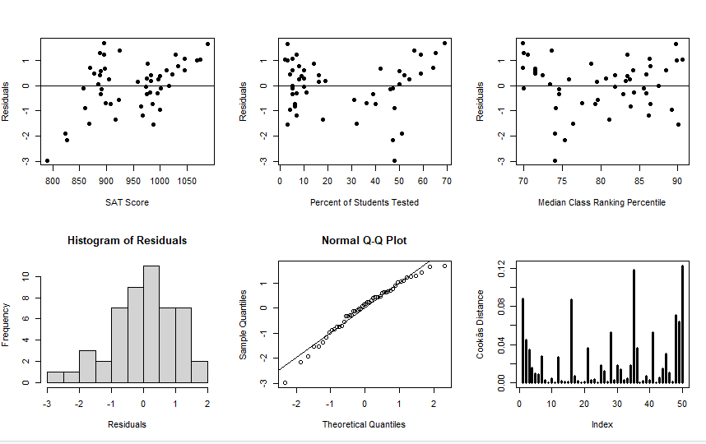
Residual Analysis

Slide 6
Residual Analysis
Transform the predicting variable Percent of Students Tested (takers)
Reanalyze heavy tailed residuals and outliers after transformation

Slide 7
Linear Regression Analysis in R
regression.line = lm(sat ~ log(takers)+rank+income+years+public+expend)
summary(regression.line)
Coefficients:
Estimate Std. Error t value Pr(>|t|)
(Intercept) 407.53990 282.76325 1.441 0.15675
log(takers) -38.43758 15.95214 -2.410 0.02032 *
rank 4.11427 2.50166 1.645 0.10734
income -0.03588 0.13011 -0.276 0.78407
years 17.21811 6.32007 2.724 0.00928 **
public -0.11301 0.56239 -0.201 0.84168
expend 2.56691 0.80641 3.183 0.00271 **
---
Signif. codes: 0 ‘***’ 0.001 ‘**’ 0.01 ‘*’ 0.05 ‘.’ 0.1 ‘ ’ 1
Residual standard error: 24.86 on 43 degrees of freedom
Multiple R-squared: 0.8919, Adjusted R-squared: 0.8769
F-statistic: 59.15 on 6 and 43 DF, p-value: < 2.2e-16

Slide 8
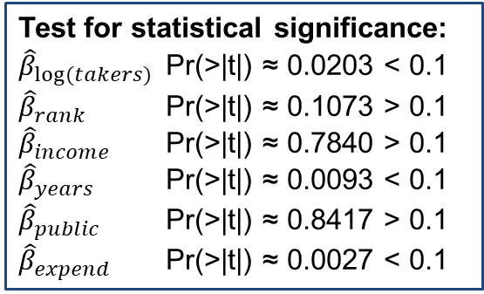
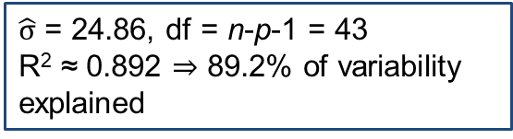
Linear Regression Analysis in R
regression.line <- lm(sat ~ log(takers)+rank+income+years+public+expend)
summary(regression.line)
Coefficients:
Estimate Std. Error t value Pr(>|t|)
(Intercept) 407.53990 282.76325 1.441 0.15675
log(takers) -38.43758 15.95214 -2.410 0.02032 *
rank 4.11427 2.50166 1.645 0.10734
income -0.03588 0.13011 -0.276 0.78407
years 17.21811 6.32007 2.724 0.00928 **
public -0.11301 0.56239 -0.201 0.84168
expend 2.56691 0.80641 3.183 0.00271 **
---
Signif. codes: 0 ‘***’ 0.001 ‘**’ 0.01 ‘*’ 0.05 ‘.’ 0.1 ‘ ’ 1
Residual standard error: 24.86 on 43 degrees of freedom
Multiple R-squared: 0.8919, Adjusted R-squared: 0.8769
F-statistic: 59.15 on 6 and 43 DF, p-value: < 2.2e-16
Test for statistical significance:
${\hat{β}}_{log⁡(takers)}$ Pr(>|t|) ≈ 0.0203 < 0.1
${\hat{β}}_{rank}$ Pr(>|t|) ≈ 0.1073 > 0.1
${\hat{β}}_{income}$ Pr(>|t|) ≈ 0.7840 > 0.1
${\hat{β}}_{years}$ Pr(>|t|) ≈ 0.0093 < 0.1
${\hat{β}}_{public}$ Pr(>|t|) ≈ 0.8417 > 0.1
${\hat{β}}_{expend}$ Pr(>|t|) ≈ 0.0027 < 0.1
$\hat{σ}$ = 24.86, df = n-p-1 = 43
R² ≈ 0.892 ⇒ 89.2% of variability explained

Slide 9
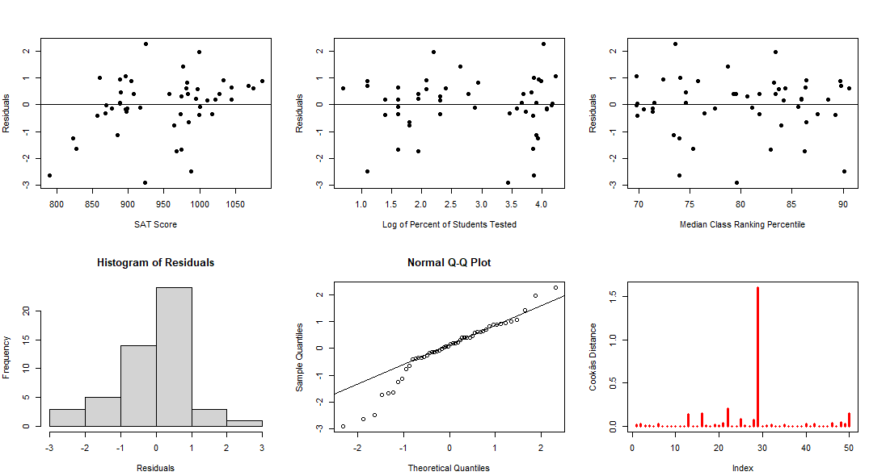
Residual Analysis

Slide 10
Residual Analysis
Transformation has improved on the linearity assumption
Heavy tailed residuals remain
Cook’s distance
  Alaska is an outlier/influential point for the model

Slide 11
State SAT Performance: Findings
Given all other predictors in the model:
  Percent of students taking SAT from a public school and family income of test takers are not statistically significantly associated to SAT score
  A $100,000 increase in the expenditure on secondary schools results in a 2.56-point increase in the SAT score
  One additional year that test takers had in social sciences, natural sciences, and humanities leads to a 17.2-point increase in the SAT score
The predictors in the model explain close to 90% of the variability in SAT score
We find that the relationship between state average SAT score and the percent of students taking SAT to be nonlinear
Ranking changes after controlling for the bias selection factors
  For example, Connecticut moves from 35th to 1st, Massachusetts from 41st to 4th, and New York from 36th to 5th

Slide 12

Summary

